Slide 1
HackBio Statistics: Lecture 1
Winfred Gatua
17/03/2021

Slide 2
Objectives
Key definitions
Sampling
Measures of Data
Data distribution
Discrete and Continuous Probability

Slide 3
Key definitions
Statistics is the science of Collecting, Summarizing, Presenting and Interpreting data
Descriptive statistics interested in basic features, obtain simple summaries, frequencies
Inferential statistics entails making inference about a population from the data
Population a collection of elements about which we wish to make inference
Sample a collection of sampling units drawn from the sampling frame

Slide 4
Continue
Parameter numerical characteristic of a population
Statistic numerical characteristic of a sample
Element an object from which a measurement is taken

Slide 5
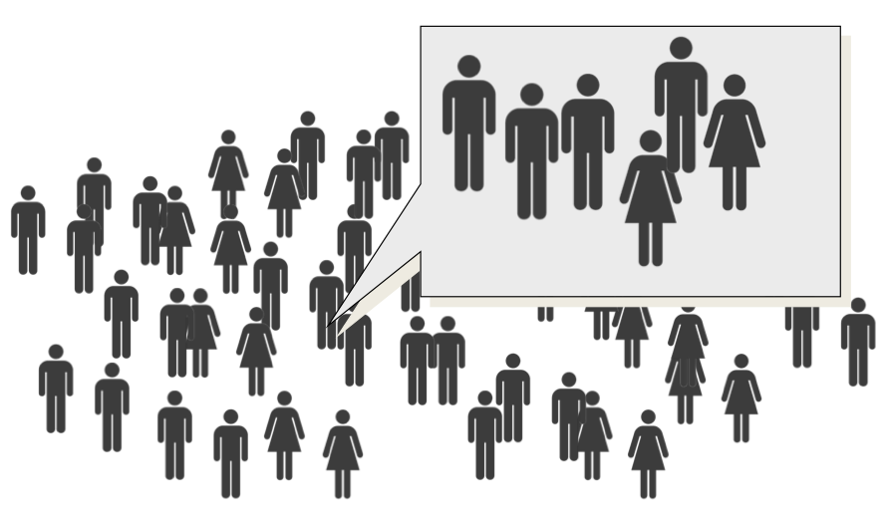
Sampling

Slide 6
Why Sample?
Pragmatic reasons
Budget and time constraints
Limited access to the total population
Accurate and reliable results
Strong similarity in population elements make it possible
Samples can yield reasonably accurate results
Destruction of test units
Reduces the cost of research in finite populations

Slide 7
Sampling methods
Probabilistic
Each member of the population has a non-zero probability of being selected
Non-probabilistic
Members are selected form the population in a non-random manner

Slide 8
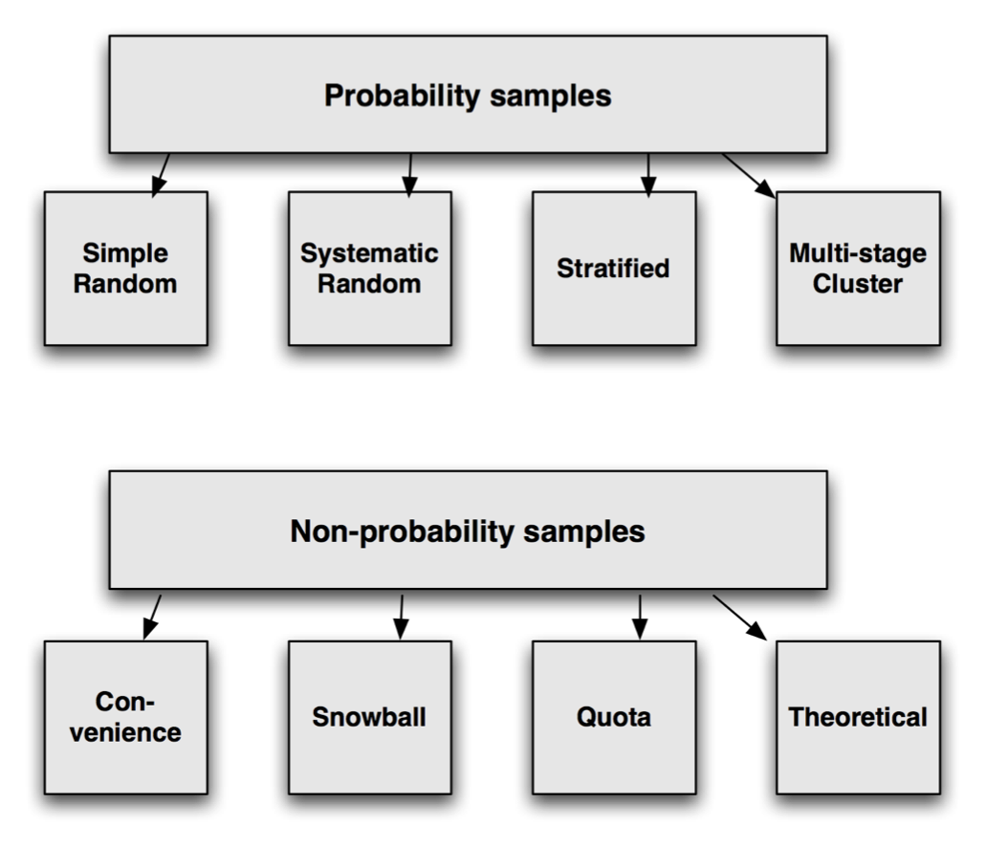
Sampling methods

Slide 9
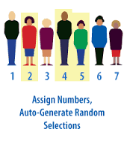
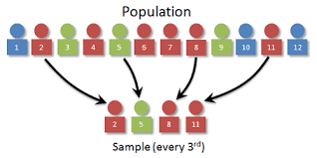
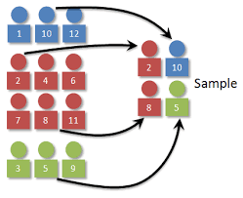
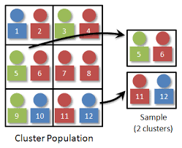
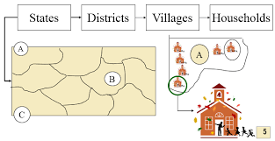
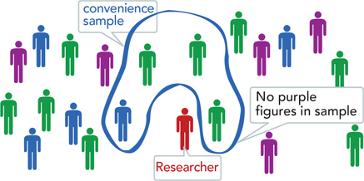
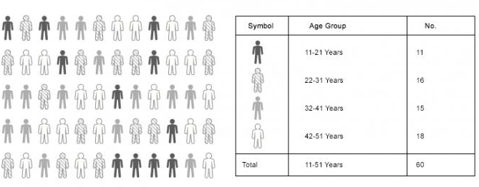
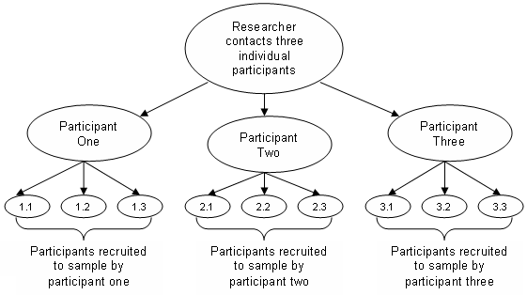
Sampling methods
Simple random sampling
Systematic sampling
Stratified sampling
Cluster sampling
Convenience sampling
Quota Sampling
Multistage sampling
Snowball sampling

Slide 10
Classes of variables
Exposures that which we wish to investigate in relationship with an outcome e.g. age, diet, treatment.
A given exposure may be associated with increased or decreased outcome
Outcome variable of interest e.g. weight gain, recovery from illness
The two should be defined before the study starts
Outcome determines the type of analysis to be done

Slide 11
Lymphocyte and Age
What is the exposure and outcome variable?

Slide 12
Variable types
Exposures that which we wish to investigate in relationship with an outcome e.g. age, diet, treatment.
A given exposure may be associated with increased or decreased outcome
Outcome variable of interest e.g. weight gain, recovery from illness
The two should be defined before the study starts
Outcome determines the type of analysis to be done

Slide 13
Variable types
Data
Categorical
Continuous
Discrete
Ordered
Unordered

Slide 14
Categorical Variables
Nominal categorical variables
Marital status
Ethnic group
None is higher than the other
Ordinal Categorical variable
Wealth status: High, Medium, Low
Education level: Primary, Secondary, College,

Slide 15
Quantitative Variable
Discrete:
No. of toys: 0, 1, 2, 3, 4, 5, …
Continuous:
Weight, Age
Interval: data with an arbitrary zero
Measured along a scale in which each position is equidistant from another
Ratio: data with an absolute zero. In a ratio scale numbers can be compared as multiples of one another
The number zero has meaning

Slide 16
Workflow of Data
Plan
Organize
Why plan?
So that one remembers what is to be done
and not end up confused
Why document?
For reproducibility.
The data and code used to make findings
must be available for an independent
researcher to recreate the findings
Document
Compute

Slide 17
Measures of Data
Measures of central tendency
Median
Mode
Mean (Arithmetic Average)
Measures of dispersion
Range
Interquartile range (IQR)
Variance
Standard deviation

Slide 18
Measures of central tendency
A summary measure that attempts to describe whole set of data with a single value that represents the middle or the centre of its distribution
Sometimes referred to as Measures of central location; classified as summary statistics
They include:
Median: Middle value in an ordered set of data, not influenced strongly by outliers
For odd n, median is in position: n+1/ 2
12,0,5,13,0,0,5,10,5,1,5,6,7,5,7,8,10,5,11,14
Arrange in order
0,0,0,1,5,5,5,5,5,5,6,7,7,8,10,10,11,12,13,14
Median?

Slide 19
Continue
Mode
Value with the highest frequency, most commonly occurring value in the dataset
Not a very good measure when the most common mark is very far away from the rest of the data
What is the mode?
Mode is 13
Value Count
10 3
11 1
12 2
13 6
15 4
18 2
14 4

Slide 20

Continue
Mean (also Arithmetic average)
Sum of all values divided by the total number of values (n)
x₁ +x₂ +x₃...+x_{n} /n= $\sum{\text{x}\text{i}/}$ n
It includes every value in the dataset

Slide 21
Continue
E.g - 0,0,0,1,5,5,5,5,5,5,6,7,7,8,10,10,11,12,13,14
Mean = 129/20 = 6.45
Limitation:
Mean includes all values and thus is influenced by outliers
For instance:
0,0,0,1,5,5,5,5,5,5,6,7,7,8,10,10,11,12,13,14, 55,60
Mean 244/29 = 11.09

Slide 22
Measures of Dispersion
Measure of spread (variability) of data
The variability in a sample displays how the observations spread out from the average
Range:
Entails the difference between the lowest and the highest values in an ordered dataset.
0,0,0,1,5,5,5,5,5,5,6,7,7,8,10,10,11,12,13,14
Range=14-0=14

Slide 23
Interquartile Range
Shows the spread of the middle 50%
0,0,0,1,5,5,5,5,5,5,6,7,7,8,10,10,11,12,13,14
IQR: 5 - 10
25th centile
Median
75th centile

Slide 24
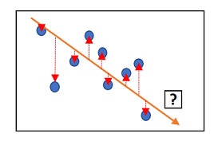
Standard deviation
Measure that summarizes the amount by which every value within a dataset varies from the mean.
Variance is calculated by summing the squares of the deviation’s from the mean and dividing by n- (second moment)

Slide 25
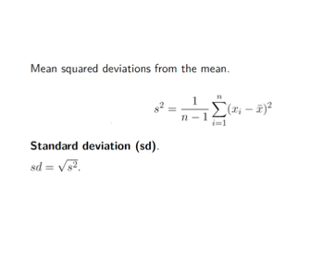
Standard deviation

Slide 26
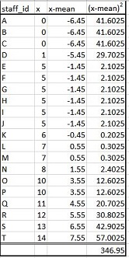
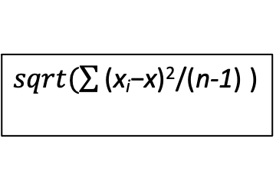
Standard deviation
$sqrt(\sum{\text{(}\text{x}\text{i}\text{−}\text{x}\text{)}\text{2}}$/(n-1) )

Slide 27
Standard deviation
Measure that summarizes the amount by which every value within a dataset varies from the mean.
Variance is calculated by summing the squares of the deviation’s from the mean and dividing by n- (second moment)

Slide 28
Statistical distribution
Distribution number of times a given quantity occurs in a dataset.
Can be represented in two ways:
Frequency distribution
Probability distribution

Slide 29
Age group (yrs) Frequency Proportion (%)
0-4 47,964 25.51
5-9 46,267 24.61
10-14 40,573 21.58
15-19 30,926 16.45
20-24 22,274 11.85

Slide 30
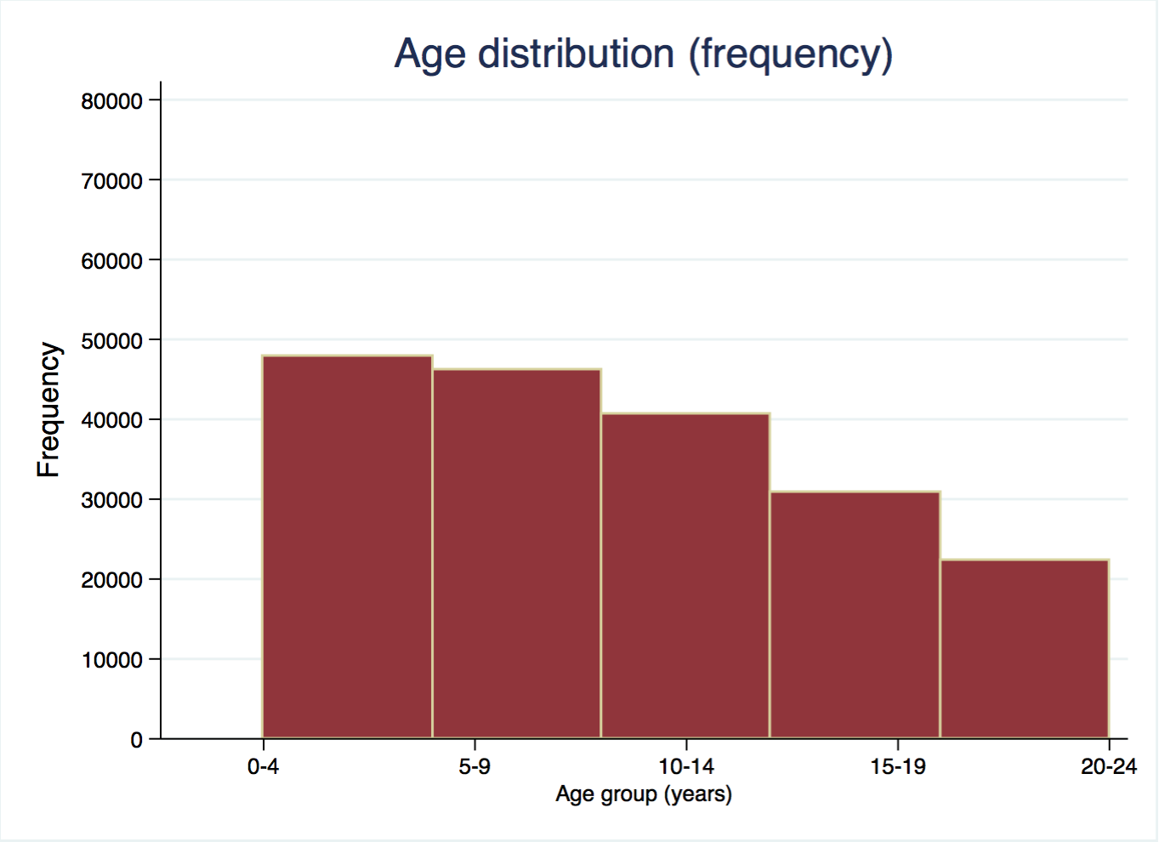
Frequency distribution
Age group (yrs) Frequency
0-4 47,964
5-9 46,267
10-14 40,573
15-19 30,926
20-24 22,274

Slide 31
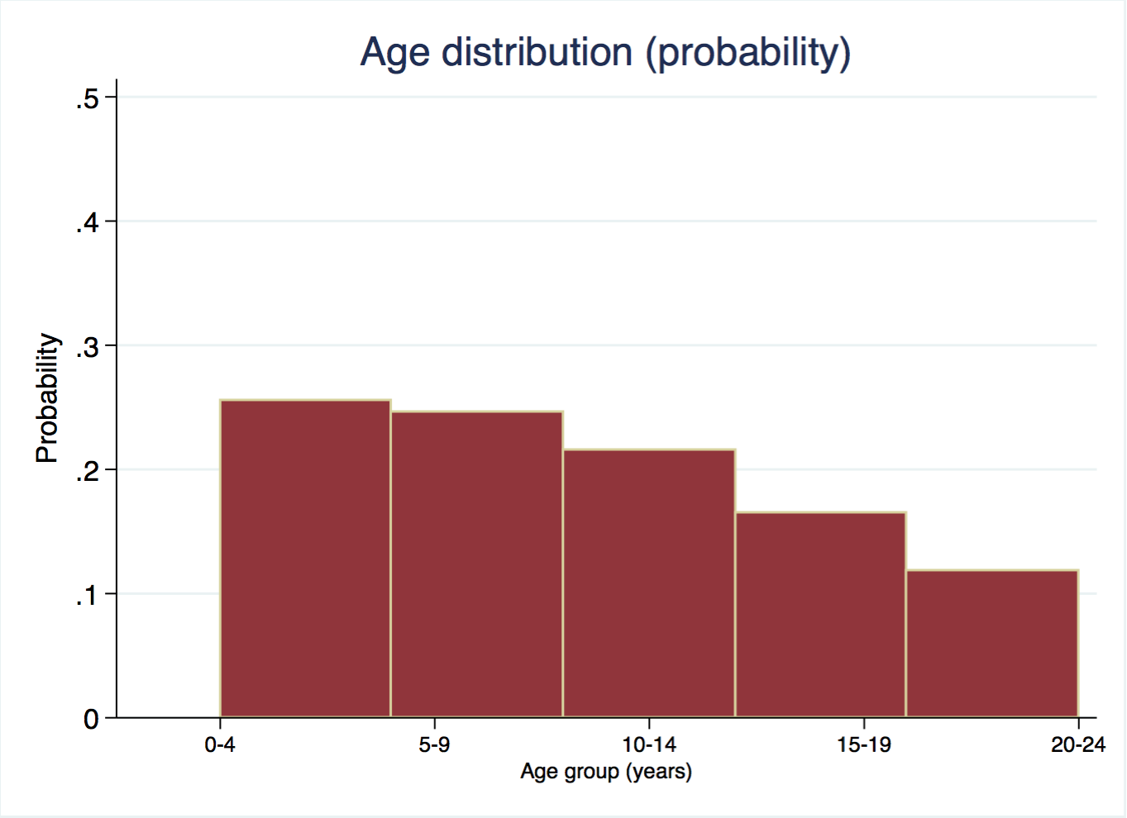
Probability distribution
Age group (yrs) Frequency Proportion (%)
0-4 47,964 25.51
5-9 46,267 24.61
10-14 40,573 21.58
15-19 30,926 16.45
20-24 22,274 11.85

Slide 32
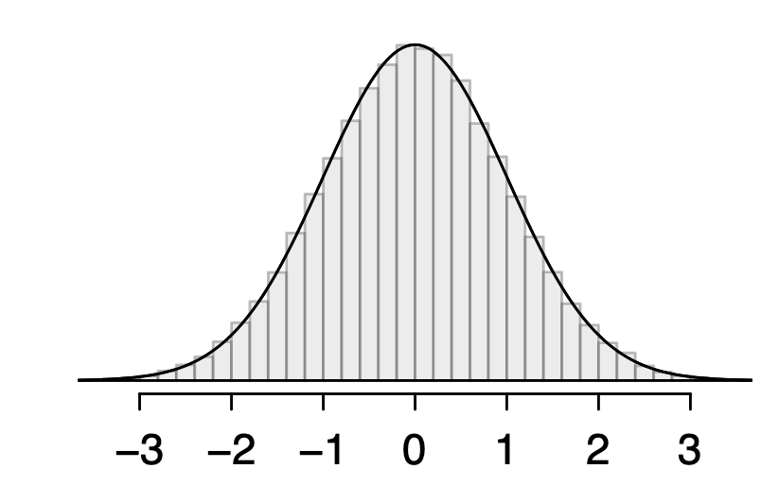
Normal distribution
For any given normal distribution characterized by by mean and standard deviation, can be represented as N(µ,𝜎): N(0,1)
Characteristics
Bell shaped
Symmetrical about the mean
Mean, median and mode are ~ equal

Slide 33
Binomial distribution
Entails multiple Bernoulli trials
Each observation represents one of the two outcomes(success or failure)
The same action is repeated n times
Probability of success is denoted as p, same for every trial
Trials are independent
Examples:
Outcome of a coin toss
Outcome of a new drug

Slide 34
Poisson distribution
Useful for estimating the number of events in a large population over a unit time
Characteristics
Used to describe discrete quantitative data e.g counts
E.g number of accidents along the highway per week

Slide 35
Other distribution
Uniform
Exponential
Geometric
Hypergeometric
Gamma
Chi - square

Slide 36
Probability
Probability is a measure of the expectation that an event will occur
Probability ranging between (0 and 1)
The higher the probability the more certain we are that the event will take place or that the statement is true

Slide 37
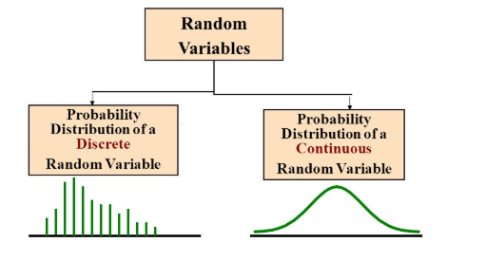
Probability distribution
Statistical function which links or lists all the possible outcomes a random variable can take, in any random process with its corresponding probability of occurrence
Values of random variables changes based on the underlying probability of distribution
Classified into two:
Discrete probability distribution
Continuous probability distribution

Slide 38
Continue
Those that can take up any value between two values are referred to as continuous variables otherwise is discrete variables.
E.g. weight between 150 and 200 pounds; continuous variable
Toss a coin repeatedly and count the number of times we see the head; discrete variable

Slide 39
Discrete Probability distribution
If a random variable is a discrete variable, its probability distribution is called discrete probability distribution
Suppose you flip a coin twice, there are four possible outcomes: HH,HT,TT and TH

Slide 40
Continuous Probability distribution
If a random variable is a continuous variable its probability is called a continuous probability distribution
Involves an equation to compute for the continuous probability distribution referred to as probability density function

Slide 41


